Slide 1
North Bay Water District
Board of directors meeting January 12, 2021

Slide 2
Challenges for Agriculture
1) Increased regulatory environment
Groundwater
Frost Protection
Endangered Species
Potter Valley
Air Quality
2) Loss of stakeholder input
3) Need for holder of industry permits

Slide 3
Solution for Agriculture
1) Establish a Water District
Legislation Driven
Landowner Driven (LAFCO)
2) Expand Existing District

Slide 4
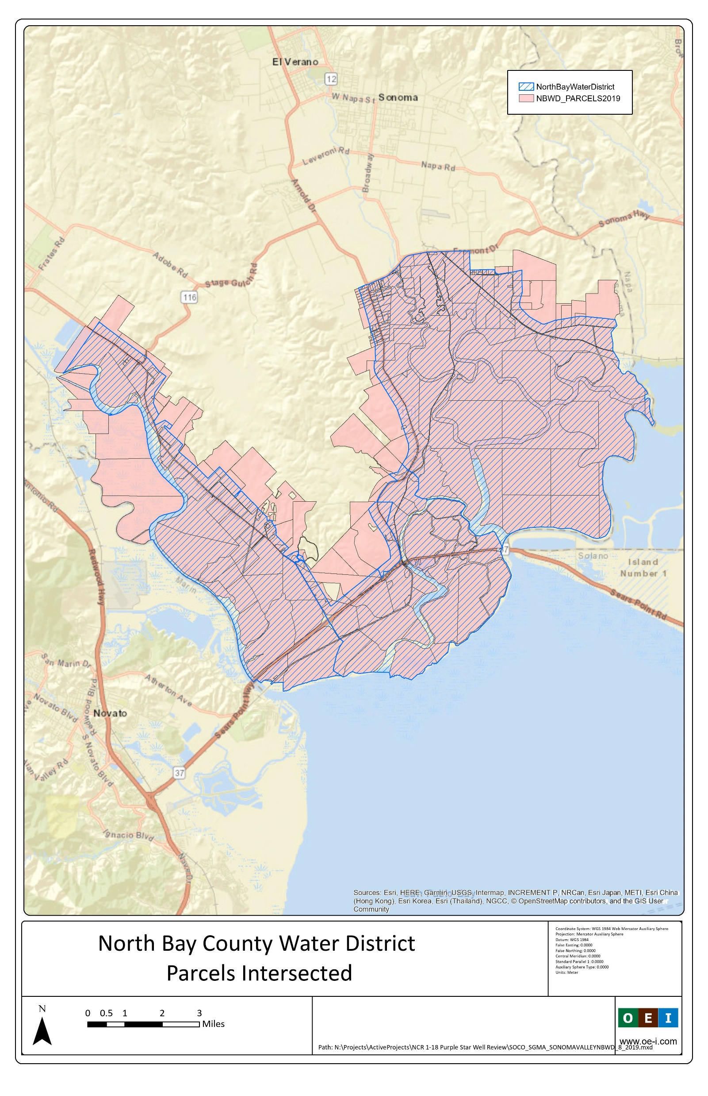
Current boundaries

Slide 5
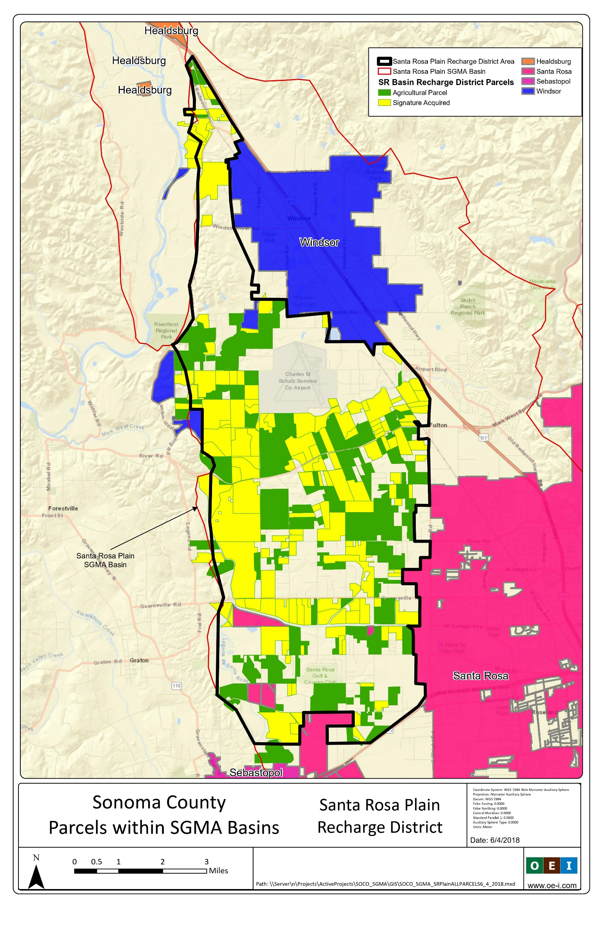
Proposed expansion into Santa Rosa Plain Basin

Slide 6
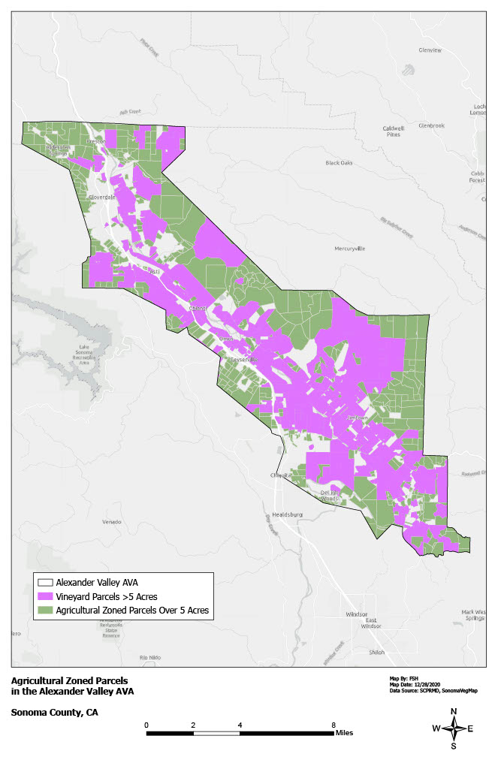
Alexander Valley AVA

Slide 7
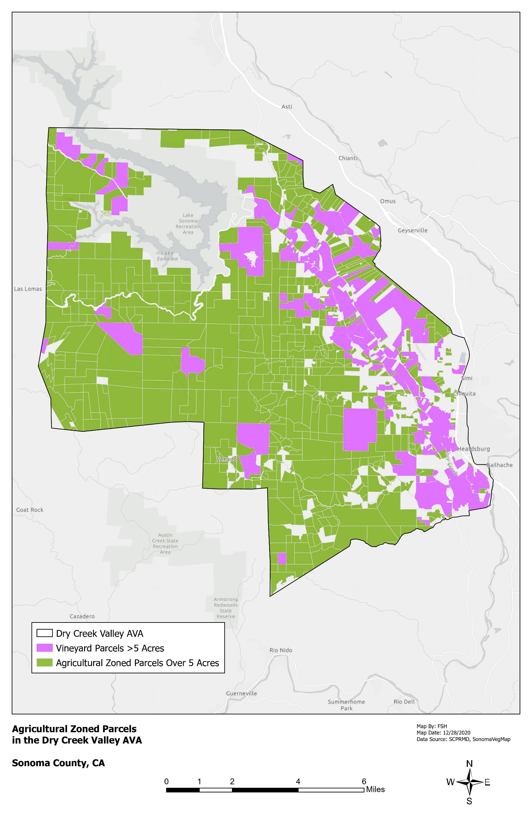
Dry Creek AVA

Slide 8
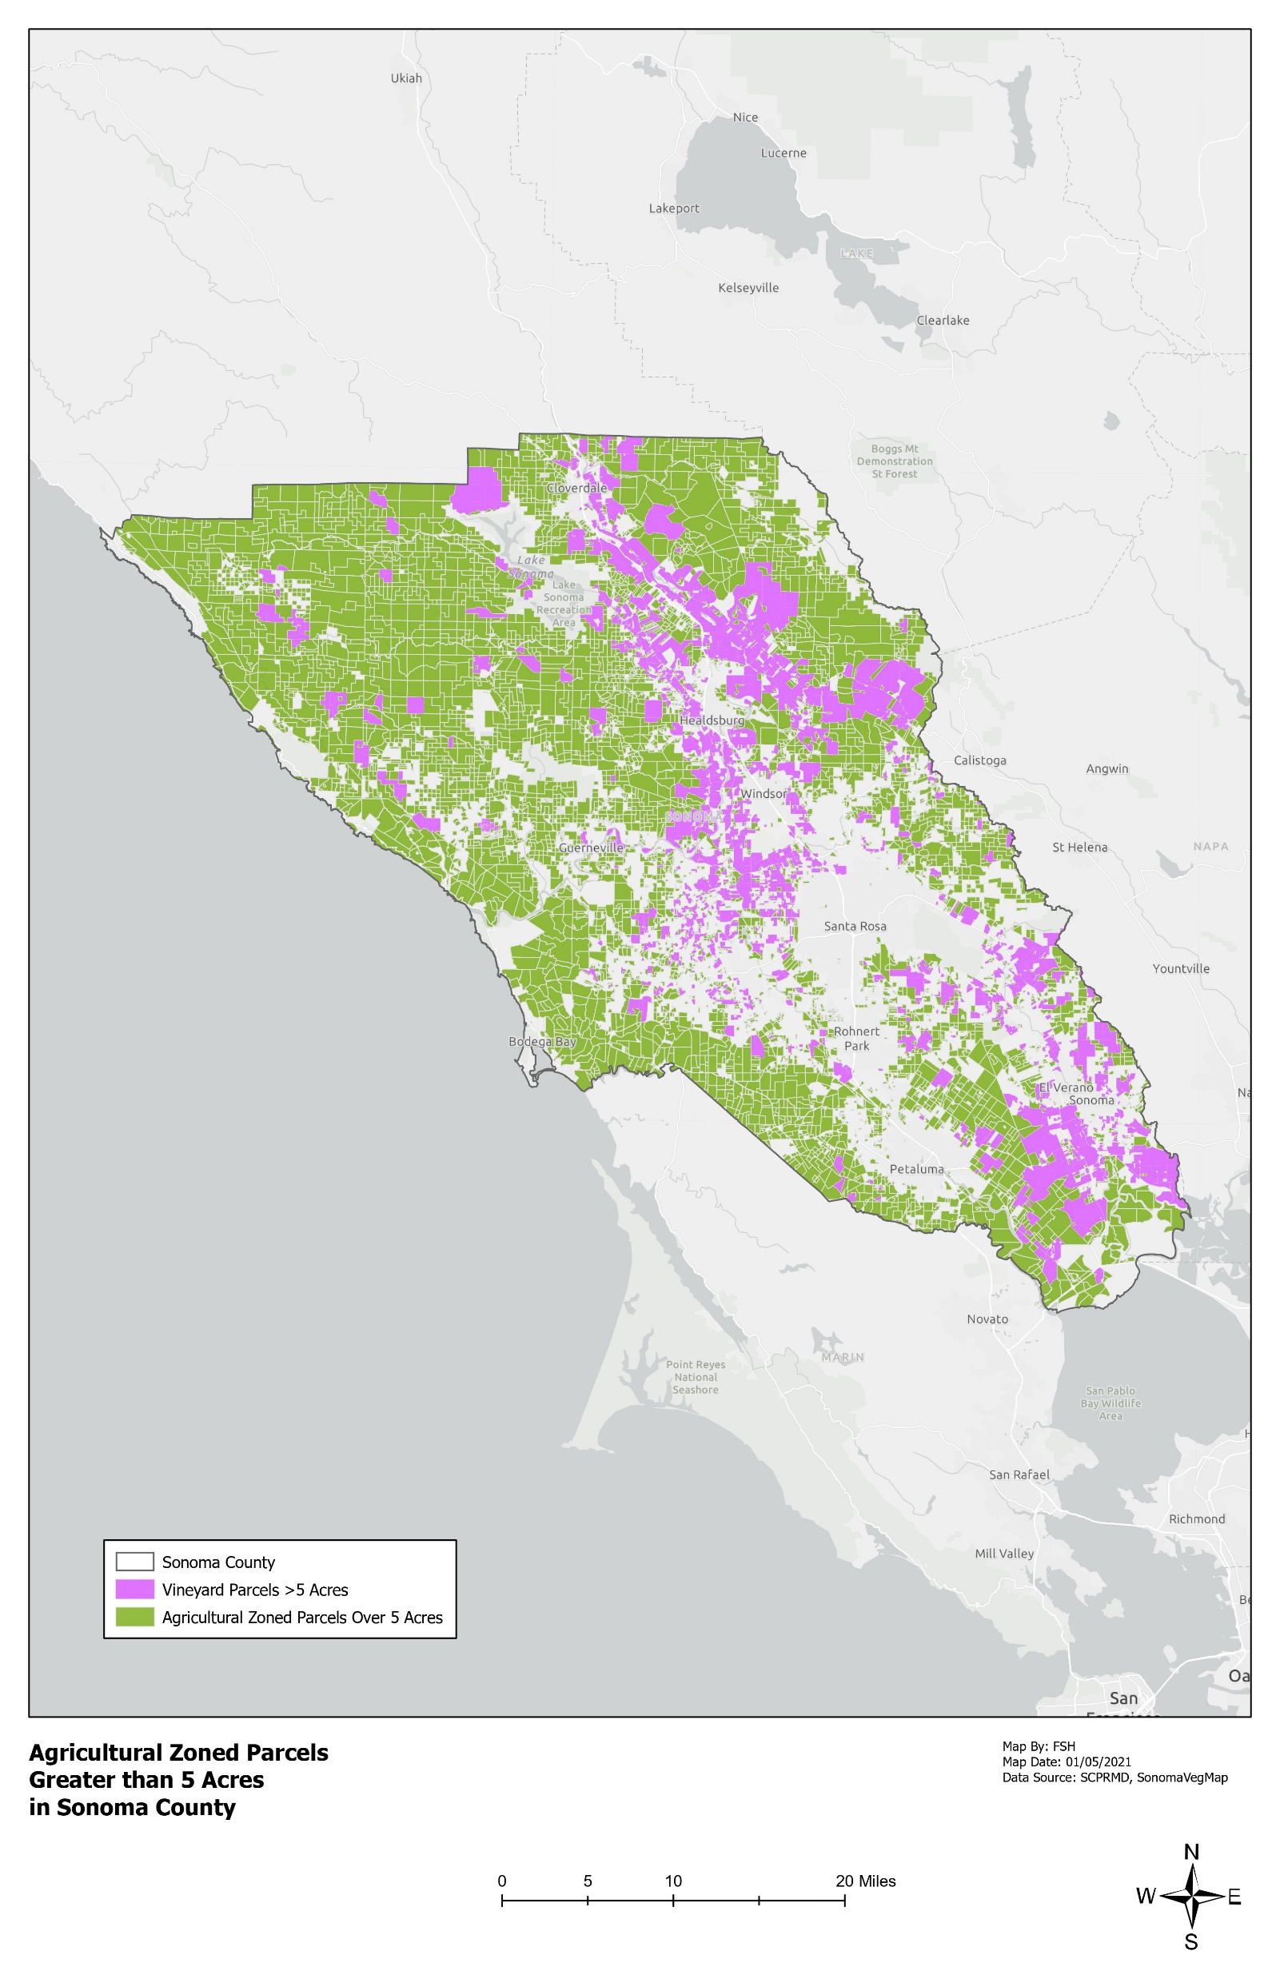
Sonoma County Ag zoned parcels over 5 acres

Slide 9
North Bay Water District
1) Quasi Governmental Agency
2) Participation in the GSA
3) Existing Boundary
4) Process & Potential for expansion

Slide 10
Benefits of the District
Organize and assert ag input in SGMA implementation
Can apply and receive state and federal grant and loan funding to make improvements within the district
Assess opportunity for ag to participate in carbon markets and groundwater credit sales
Huge cost savings for landowners based on reduction of costs including permits and implementation of regulation

Slide 11
Benefits of the District
Opportunity to coordinate with the Sonoma County Farm Bureau to manage and administer the following programs:
Groundwater Sustainability Farm Plan
Stationary Engine Replacement Program
Safe Harbor Agreement for CA Tiger Salamander mitigation
Russian River Frost Protection Program
Future programs related to flood protection
Other unspecified programs that address current/future regulations

Slide 12
Proposed Assessment
Funding for the District will be in the form of an assessment further described below:
Parcels designated agricultural by the Sonoma County General Plan will be assessed at:
$15 per acre for irrigated lands (5,535 acres at $15 per acre) or $83,025
$1 per acre for non-irrigated lands (20,220 acres at $1 per acre or $20,220)
Total of $103,245.

Slide 13
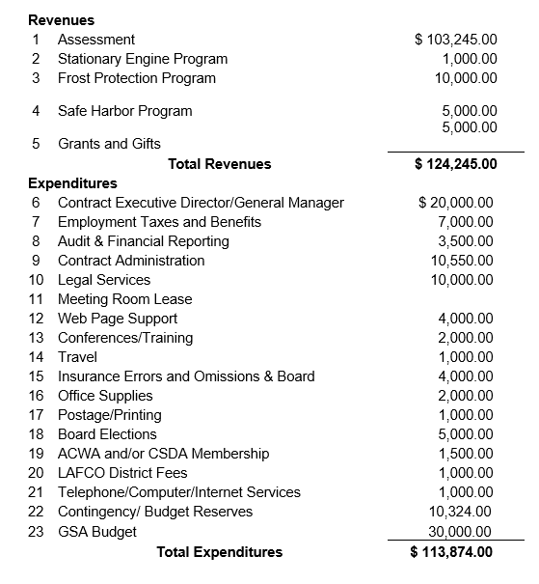
NBWD Draft Budget for 2021

